Slide 1
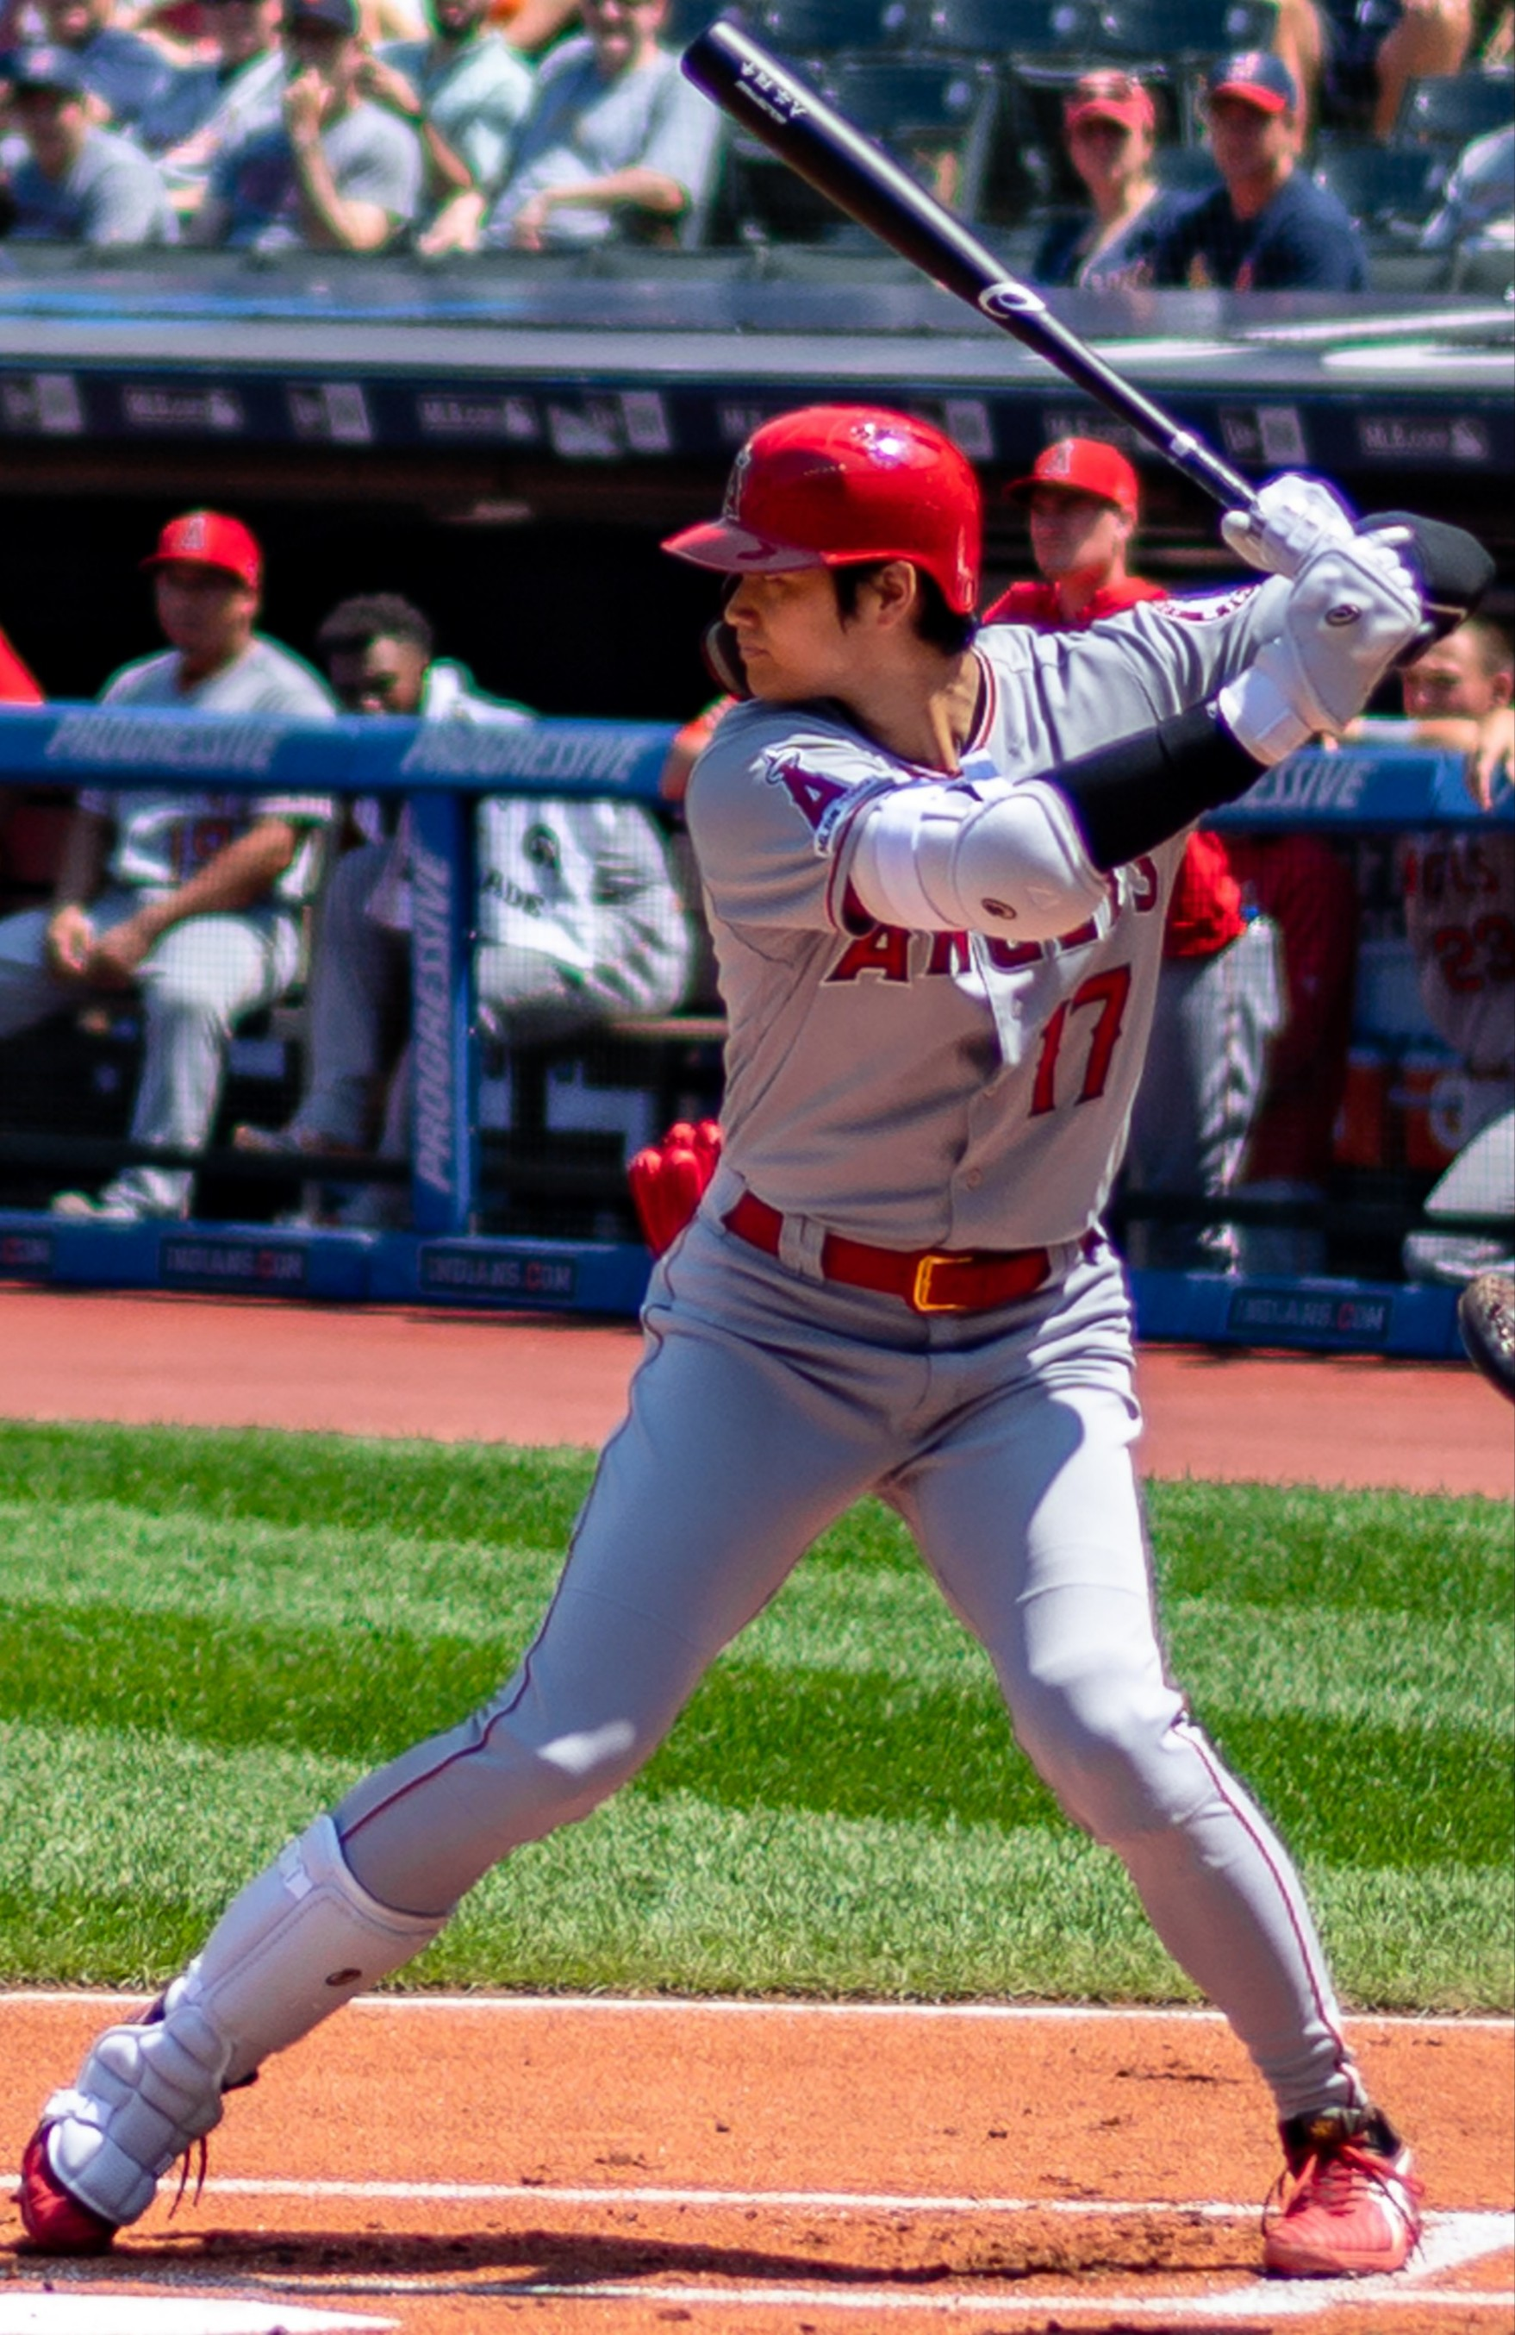
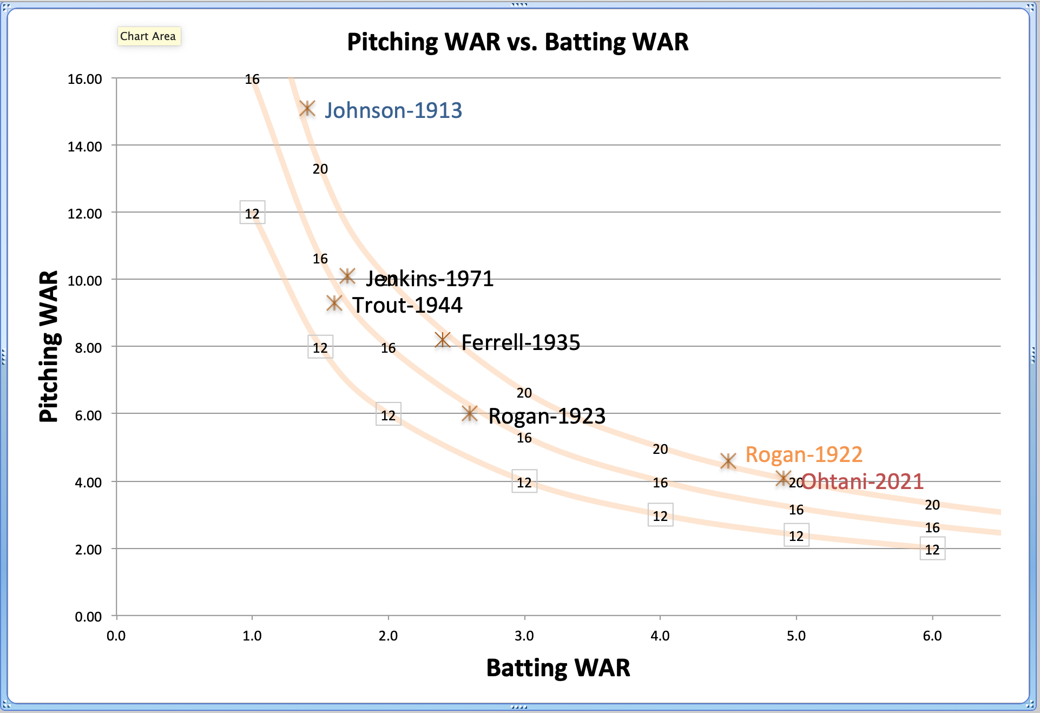
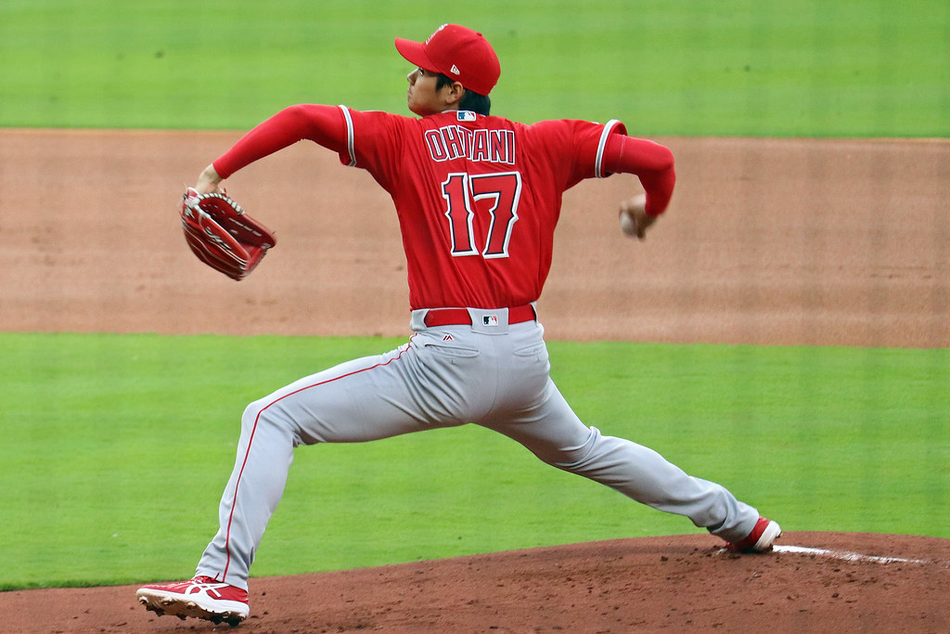
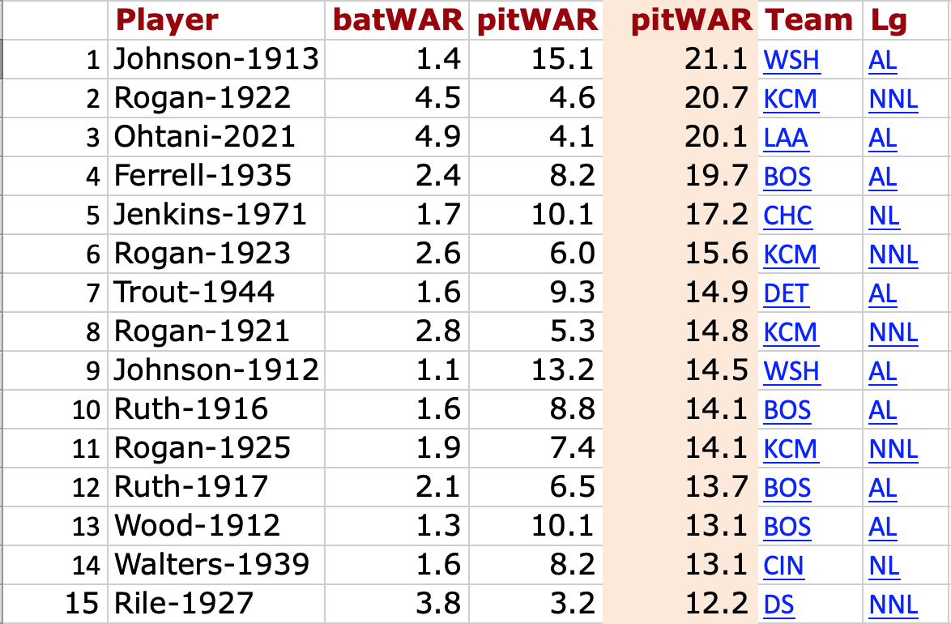
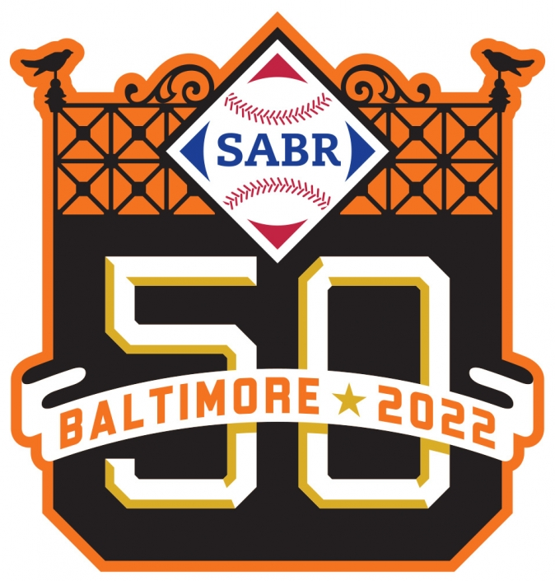
Was Shohei Ohtani’s 2021 Season the Best Two-Way Season Ever?
Dale Mahoney, SABR Member, at the SABR 50 Annual Convention
Shohei Ohtani? Ohtani Shohei? Ōtani Shōhei? 大谷 翔平?
Representing foreign names in English has always been a challenge. Witness the Ponle Acento (“Add the accent”) movement in MLB in 2015 to add accents and tildes to Latin names on jerseys and in print.
Ohtani’s name in Kanji is 大谷 翔平, the romanization, or rōmaji, of which is Ōtani Shōhei. Japanese broadcaster NHK now refers to Japanese people in English with their surname first, in the common Asian way. NHK now calls him “Ohtani Shohei” in their English press and broadcasts. Western media (AP, Reuters, NPR, NY Times) still refer to him as “Shohei Ohtani,” which is also how Ohtani refers to himself in English. So I’ve kept that convention everywhere here.
But we have appropriately added accents and tildes to Latin names, and someday we might well change how we refer to players from East Asian countries.
Shohei Ohtani in 2021
Shohei Ohtani had a tremendous 2021 with a Baseball-Reference.com Wins Above Replacement (WAR) of 4.9 due to hitting and was the starting pitcher in 23 games, 130.1 innings, with a BB-Ref pitching WAR of 4.1, for a total WAR of 9.0. He unanimously won the American League MVP. Only 18 other players in history have been voted unanimous MVP. He was the most valuable player in the AL by 1.8 WAR, and the best in MLB by 1.4 WAR.
It was clearly the best performance of 2021. But was it the best two-way season since 1901?
The Method
Using Baseball-Reference.com’s Stathead, I searched for the batting WAR (batWAR) for all players from 1901 on who pitched in at least 10 games. Then I found their pitching WAR (pitWAR) for that season.
So Was Ohtani’s 2021 The Greatest Two-Way Season Ever?
Ohtani’s 2021 season was the best two-way season in the 121 years of the AL or the 146 years of the NL. No one had more than 4 WAR offensively and defensive. Or 3 WAR in each. Or 2.5 WAR in each.
It gets more complicated when you include the 1920s Negro National League, where “Bullet Joe” Rogan might have had a better season.
So like many historical questions in baseball, the answer is maybe. But given the greater pool of players today playing at a much higher talent level, Ohtani’s 2021 has a great claim to the best two-way season of all-time.
Ohtani is having a fine 2022 season—5.6 WAR, 2.0 batting WAR, 3.6 pitching WAR through 117 team games—but it doesn’t appear that he will best 2021. But there’s always 2023 and beyond, and maybe in a future season he’ll exceed 2021 by such a margin to make this argument moot.
Isn’t Babe Ruth the Best Two-Way Player?
Despite his reputation, Babe Ruth is easy to rule out as the best two-way player in MLB history. He was a tremendous pitcher in 1916 (8.8 WAR) and 1917 (6.5 WAR). But he was merely good as a hitter then, (1.6 WAR in ’16 and 2.1 WAR in ’17.) In 1918, he had a breakout offensive season with 4.6 WAR, but his pitching dropped to 2.3 WAR. In 1919, Ruth became a great offensive player with 9.1 WAR, but his pitching continued to decline, to only 0.8 WAR. By 1920, he was a Yankee and rarely pitched again.
Ah, But What About Charles Wilber (or Wilbur) “Bullet Joe” Rogan?
No mention of major leaguers and two-way players is complete without mentioning Negro League players, who were denied the chance to play in the major leagues due the ugly horror of segregation.
“Bullet Joe” Rogan was the best of the Negro Leagues’ two-way players. In 1922, he earned a stunning WAR of 9.1 in only 74 games in the 1922 Negro National League.
The 1922 Negro National League (NNL) was a young 8-team league, in just its third year, with only Rogan’s Kansas City Monarchs (80) and the Indianapolis ABCs (85) playing 80 or more games. Two teams played only 41 and 38 official games. It’s very difficult to access the quality of the opposition in the 1922 NNL, and that is beyond the scope of this presentation. And, of course, we can also make similar arguments about Ruth, Johnson and others about the competition they faced pre-1925 in their 8-team leagues.
Surely, if Rogan could have performed at only 60% of his 1922 NNL level for a full season in the AL or NL, he would have clearly been the best two-way player in MLB history. (Of course, you always have to be careful of “on pace” arguments—on June 30, 2021, Ohtani was on pace for a stunning 11.7 WAR.)
Unfortunately, segregation from 1920-1948 denied us the chance to see all of the best baseball players play against each other, including “Bullet Joe” Rogan.
What About Walter Johnson?
By multiplying his 1.4 offensive WAR with his eye-popping 15.1 pitching WAR, Walter Johnson’s 1912 season appears to be the best in AL history, beating Ohtani 21.1 to 20.1. But was Johnson really a “two-way” player? In his tremendous 1913 season, he only appeared in 7 games as a hitter where he did not pitch. He appeared in only 55 of his team’s 155 games. He never had a season where he was worth more than 1.8 WAR as a hitter. Johnson was a pitcher who could hit, and who occasionally pinch-hit, but he was not a “two-way” player.
Acknowledgements:
All WAR numbers came from Baseball-Reference.com
Images are covered by the Creative Commons License:
https://creativecommons.org/licenses/by/2.0/legalcode
Negro League data also came from BB-Ref.com, by way of Seamheads.com (Gary Ashwill, Scott Simkus, Mike Lynch, Kevin Johnson and Larry Lester.)
Thanks to SABR member David Peng, huge Angel and Ohtani fan, for the inspiration for my first SABR presentation.
Additional materials https://clearskiesagility.com/dale-mahoneys-page-for-sabr-etc-stuff/
Any and all errors are mine. Fixing them is an exercise for the reader. :-)

